Slide 1
SOFTWARE
ENGINEERING FUNDAMENTALS: JAVA
MODULE 2 – INTRODUCTION TO JAVA
Notes:
Course #Z16325
© 2009 Accenture All Rights Reserved.
Solutions Engineering Fundamentals: Java

Slide 2
MODULE OBJECTIVE
At the end of this module, you will be able to:
  Describe the primary concepts that support Java technology
  Explain how Java achieves platform independence
  Discuss the different tools and libraries available as part of the Standard Java Development KIT (J2SE JDK)
  Install and configure the required software, tools, and libraries to get started with Java
  Write, compile, and execute simple Java applications
Notes:
Course #Z16325
© 2009 Accenture All Rights Reserved.
Solutions Engineering Fundamentals: Java

Slide 3
THE JAVA PROGRAMMING LANGUAGE
The Java programming language is a fully object-oriented language.
The standard edition provides pre-built libraries and APIs that provide useful capabilities out of the box.
Java is portable. The Java language and libraries are platform-independent.
Java is multi-threaded. Java has a sophisticated set of synchronization primitives that are based on the widely used monitor and condition variable paradigm.
Java is robust. Programmers don't have to worry about freeing or corrupting memory.
Notes:
Course #Z16325
© 2009 Accenture All Rights Reserved.
Solutions Engineering Fundamentals: Java
Explain that Java is an entire platform, not just a programming language.

Slide 4
THE JAVA TECHNOLOGY PLATFORM
Java applications run on a virtual machine environment that:
  Isolates the underlying platform
  Achieves portability and performance
  Provides security
Java source code is written as plain text files (.java) that are compiled as platform independent byte-codes (.class)
Java byte-codes are interpreted and executed by the virtual machine that passes the instructions to the actual platform
Notes:
Course #Z16325
© 2009 Accenture All Rights Reserved.
Solutions Engineering Fundamentals: Java
The virtual machine provides a standardized environment for byte-codes to execute. By isolating and hiding the underlying hardware platform, Java programmers will not have worry about the specifics of their target platform when writing code. All compliant virtual machines are capable of reading byte-codes. Byte codes can be executed from one VM to another without a need to re-compile

Slide 5

THE JAVA TECHNOLOGY PLATFORM
Java Byte-Code
(.class)
JVM
(Win32)
Java Source File
(.java)
Java Byte-Code
(.class)
Java Compiler
JVM
(Solaris)
Java Byte-Code
(.class)
JVM
(Mac OS)
Notes:
Course #Z16325
© 2009 Accenture All Rights Reserved.
Solutions Engineering Fundamentals: Java
Explain that Java is an entire platform, not just a programming language. This slide summarizes all the important aspects and features commonly associated with the term ‘Java’
The virtual machine provides a standardized environment for byte-codes to execute. By isolating and hiding the underlying hardware platform, Java programmers will not have worry about the specifics of their target platform when writing code. All compliant virtual machines are capable of reading byte-codes. Byte codes can be executed from one VM to another without a need to re-compile
Some java-enabled web browsers have their own JVM separate from the one used by the platform

Slide 6
JAVA DEVELOPMENT KIT
Java Development Kit (JDK):
  Is a set of software, tools and libraries that need to be installed in order to start writing and compiling Java applications
  Installs the virtual machine (runtime environment) needed in order to execute Java applications on the platform
    The virtual machine can be downloaded separately from the JDK as a JRE (Java Runtime Environment) download
Notes:
Course #Z16325
© 2009 Accenture All Rights Reserved.
Solutions Engineering Fundamentals: Java
As of this writing Java is now at version 6
The download is at http://java.sun.com
A copy of the installer should be with the SEF kit

Slide 7
ACTIVITY
Install the Java Development Kit
Install an IDE (Eclipse)
Create and configure a project inside Eclipse importing the SEF work files
Compile and execute a simple Java application
Notes:
Course #Z16325
© 2009 Accenture All Rights Reserved.
Solutions Engineering Fundamentals: Java
As of this writing Java is now at version 6
The download is at http://java.sun.com
A copy of the installer should be with the SEF kit

Slide 8
INSTALLING THE JDK
The License Agreement of the JDK used in this course is found in the Appendix section of this module.
If the installer isn’t locally available, go to http://java.sun.com and download the J2SE6 installer
  Make sure to download the appropriate ‘JDK’ version for your platform
Once the installer is available, execute the installer and follow the prompted procedures.
  Just choose the default choices for any installation options
Notes:
Course #Z16325
© 2009 Accenture All Rights Reserved.
Solutions Engineering Fundamentals: Java
JDK license details can be found in the Appendix section of this module.
For the remainder of the course, JavaSE6 and the Eclipse IDE software will be used
In Windows, by default it should go to C:\Program Files\Java\jdk1.6.0_04\ and C:\Program Files\Java\jre1.6.0_04 (the version numbers might change depending on what was downloaded)

Slide 9
INSTALLING THE JDK
In the JDK<version number>\bin directory, the compiler can be invoked by executing the application called ‘javac’:
  Syntax:
    javac <source file>
  Example:
    javac HelloWorld.java
In the same directory, an application can be run using the virtual machine by executing the application called ‘java’:
  Syntax:
    java <class file>
  Example:
    java HelloWorld
Notes:
Course #Z16325
© 2009 Accenture All Rights Reserved.
Solutions Engineering Fundamentals: Java

Slide 10
INTEGRATED DEVELOPMENT ENVIRONMENT
Java source files are in text format and can be written using any text editor
For greater productivity, download and install an Integrated Development Environment (IDE). An IDE:
  Provide you with a set of tools that assist in developing, testing, and debugging Java applications
  Popular IDEs are :
    NetBeans (from http://java.sun.com)
    Eclipse (http://eclipse.org)
Notes:
Course #Z16325
© 2009 Accenture All Rights Reserved.
Solutions Engineering Fundamentals: Java
For the remainder of the course, JavaSE6 and the Eclipse IDE software will be used

Slide 11
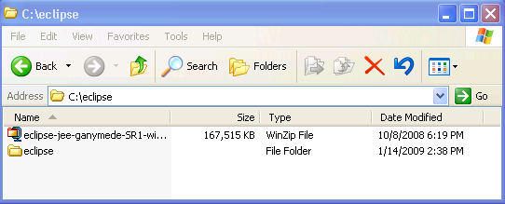
INSTALLING AND CONFIGURING ECLIPSE
http://www.eclipse.org/ and download the Eclipse IDE.
The installer should be an archive file.
Extract the files in the archive to a directory of your choice (c:\eclipse in the example below).
Notes:
Course #Z16325
© 2009 Accenture All Rights Reserved.
Solutions Engineering Fundamentals: Java
The Eclipse that will be used is an Accenture approved OSS.
Eclipse license details can be found in the Appendix section of this module.
There might be different flavors of Eclipse available. For this course, the most appropriate download would be Eclipse IDE for Java EE developers or Eclipse IDE for Java Developers. The screenshots here were made using the Eclipse IDE for Java EE (Ganymede) release

Slide 12
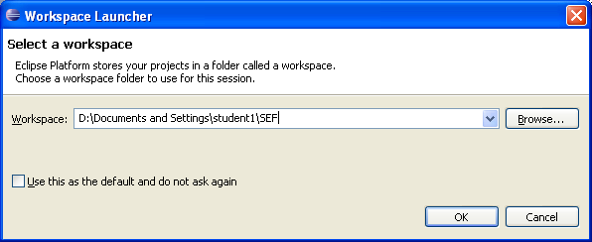
INSTALLING AND CONFIGURING ECLIPSE
Once extracted, go to the directory, find the executable ‘eclipse.exe’ and create a shortcut to it
Place the shortcut in a convenient location and double- click the shortcut to launch the Eclipse IDE
After the splash screen, the IDE will prompt you to create a workspace. Name the workspace ‘corejavaex’
Notes:
Course #Z16325
© 2009 Accenture All Rights Reserved.
Solutions Engineering Fundamentals: Java
The workspace is where all your projects and files will be stored. You can create several workspaces. Whenever you launch eclipse, the prompt will show up asking you wish workspace to use, or to create a new one if the specified directory doesn’t exist yet.

Slide 13
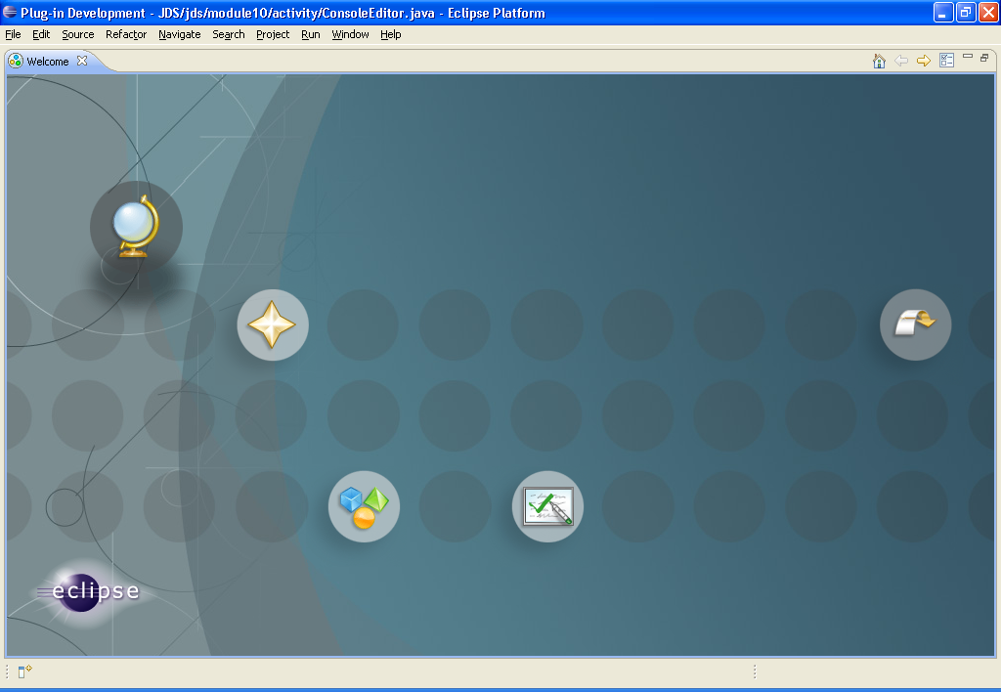
INSTALLING AND CONFIGURING ECLIPSE
If it is your first time using eclipse, the ‘Welcome’ window should give you some first-timer options and tutorials.
Close the window for now. This can be accessed any time under the ‘Help->Welcome’ menu
Notes:
Course #Z16325
© 2009 Accenture All Rights Reserved.
Solutions Engineering Fundamentals: Java
If you have time, you might want to try out the different samples and tutorials

Slide 14
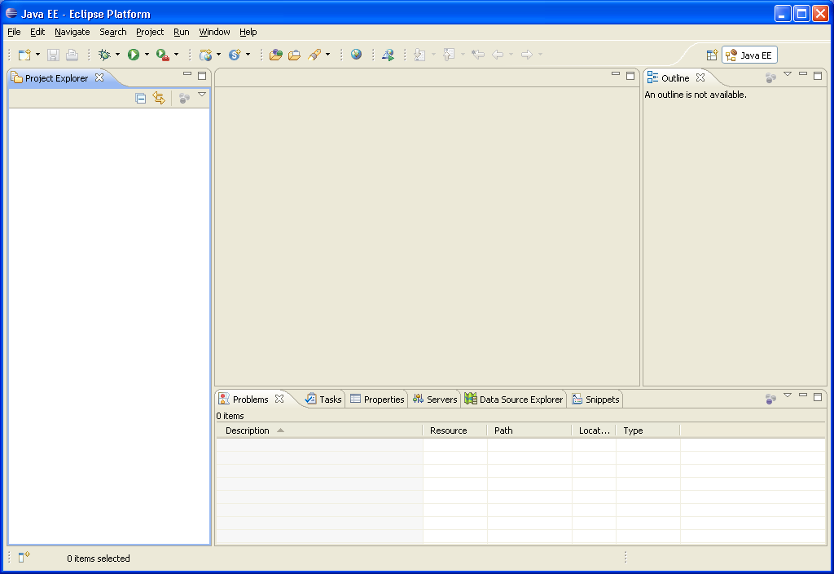
INSTALLING AND CONFIGURING ECLIPSE
The editor window is where the selected component can be viewed and edited
The Project explorer allows you to browse the contents of the various projects you have created under the workspace
Information tabs at the bottom provide additional information about the application/component selected
The outline view allows you to look at the various elements of a component selected from the project explorer
Notes:
Course #Z16325
© 2009 Accenture All Rights Reserved.
Solutions Engineering Fundamentals: Java
All of the subsections of the workbench can be moved and resized

Slide 15
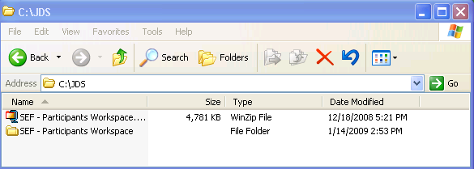
INSTALLING AND CONFIGURING ECLIPSE
Extract the SEF – Participants Workspace to any directory you want.
In this example, the zip file is extracted to C:\JDS
Notes:
Course #Z16325
© 2009 Accenture All Rights Reserved.
Solutions Engineering Fundamentals: Java
All of the subsections of the workbench can be moved and resized

Slide 16
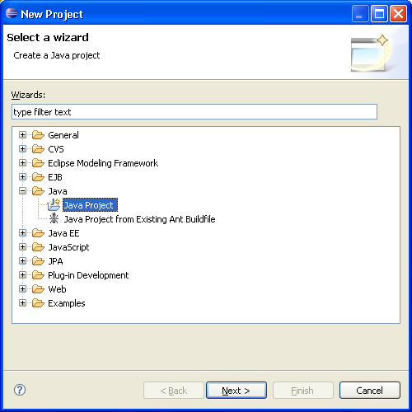
INSTALLING AND CONFIGURING ECLIPSE
Create a new project by selecting File->New->Project
In the wizard, select Java Project
Notes:
Course #Z16325
© 2009 Accenture All Rights Reserved.
Solutions Engineering Fundamentals: Java
The kind of project chosen will dictate what kind of environment the workbench will configure itself to have. Since we’re only dealing with core Java applications, a basic Java Project will suffice

Slide 17
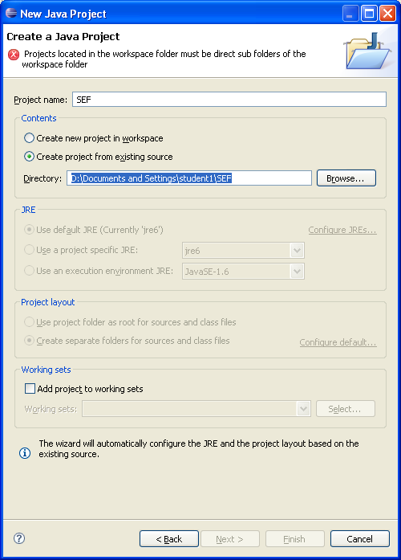
INSTALLING AND CONFIGURING ECLIPSE
Use ‘SEF’ as the project name
Select ‘Create Project from an existing source’ and browse to the directory named SEF under the directory where the Eclipse SEF Participants Workspace archive is extracted
Click ‘Finish’ as we don’t need the other steps
Notes:
Course #Z16325
© 2009 Accenture All Rights Reserved.
Solutions Engineering Fundamentals: Java
You can create completely new projects from this page as well, without having to import from files. Just select ‘create new project’
There is a selector for the JRE because its possible your machine will have different versions of JREs available. Of particular note is that pre 1.5 JREs have considerable syntax differences with more current JREs (1.5 and above)

Slide 18
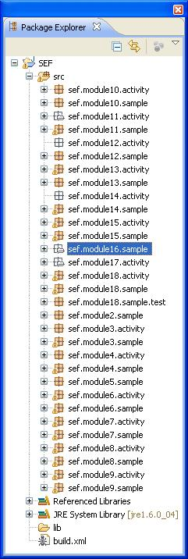
INSTALLING AND CONFIGURING ECLIPSE
The work files for this training is divided into packages for each module
In the package explorer, go to sef.module2.sample and double click the file ‘HelloWorld.java’
The main editor view should show the contents of the HelloWorld.java file and the outline view should show the different elements of that file
Notes:
Course #Z16325
© 2009 Accenture All Rights Reserved.
Solutions Engineering Fundamentals: Java

Slide 19
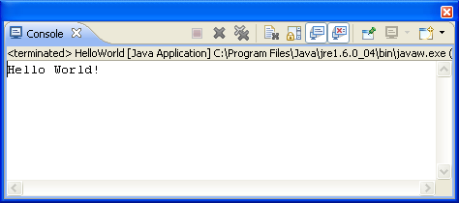
INSTALLING AND CONFIGURING ECLIPSE
The HelloWorld file is a Java executable
Execute the file by right clicking the file->Run As->Java application
The console tab below the main editor should show the results of the application
Notes:
Course #Z16325
© 2009 Accenture All Rights Reserved.
Solutions Engineering Fundamentals: Java
Eclipse auto compiles codes whenever you save or make changes to them. Working with an IDE is preferable since it simplifies and automates many tasks. However, it is possible to compile and execute using the console.
In the JDK\bin directory of your java installation there should be a file called ‘javac’ which is the compiler. The basic syntax for use is
Javac <source file>
Example: javac HelloWorld.java
To execute the application using the command line, look for the ‘java’ file in the same directory. The syntax is
Java <class file>
Example java HelloWorld
The .class files are needed when executing the file, not the .java file. Executing the sample above will tell the JVM to execute the byte code file ‘HelloWorld.class’

Slide 20
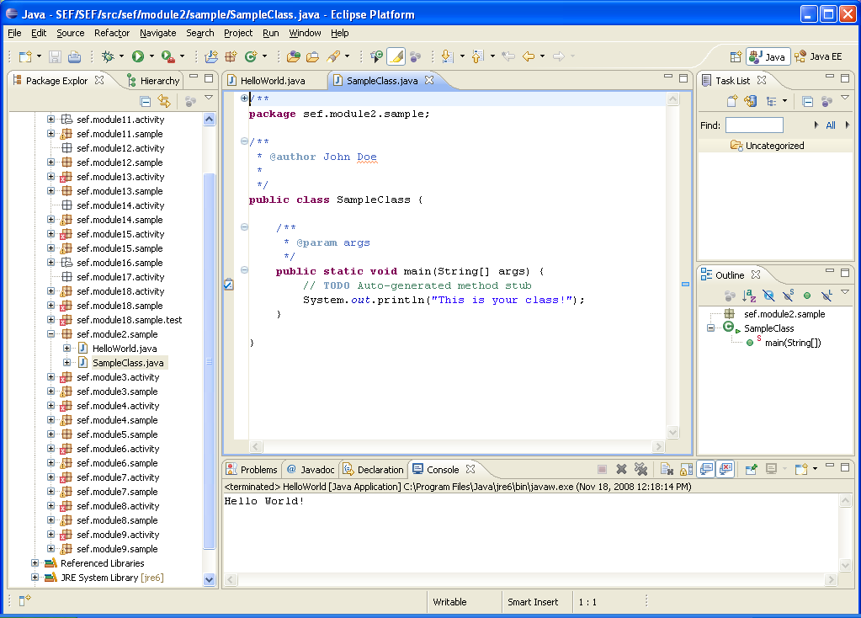
CREATE A NEW JAVA CLASS
Right-click on the package sef.module2.sample and select New->Class
Give the class a name ‘SampleClass’
Add ‘public static void main(String arg[]) in the method stubs
Click ‘Generate Comments’
Click Finish when done
Notes:
Course #Z16325
© 2009 Accenture All Rights Reserved.
Solutions Engineering Fundamentals: Java
Eclipse auto compiles codes whenever you save or make changes to them. Working with an IDE is preferable since it simplifies and automates many tasks. However, it is possible to compile and execute using the console.
In the JDK\bin directory of your java installation there should be a file called ‘javac’ which is the compiler. The basic syntax for use is
Javac <source file>
Example: javac HelloWorld.java
To execute the application using the command line, look for the ‘java’ file in the same directory. The syntax is
Java <class file>
Example java HelloWorld
The .class files are needed when executing the file, not the .java file. Executing the sample above will tell the JVM to execute the byte code file ‘HelloWorld.class’

Slide 21
CREATE A NEW JAVA CLASS
Complete the main method by typing:
  public static void main(String[] args) {
  // TODO Auto-generated method stub
  System.out.println("This is your class!");
  }
Compile and execute the new class and view the results!
Notes:
Course #Z16325
© 2009 Accenture All Rights Reserved.
Solutions Engineering Fundamentals: Java

Slide 22
APPENDIX
ECLIPSE
  Version : 3.4
  License : http://www.opensource.org/licenses/eclipse-1.0.php
JDK
  Version : 1.6
  License : http://java.sun.com/javase/6/jdk-6u10-license.txt
Notes:
Course #Z16325
© 2009 Accenture All Rights Reserved.
Solutions Engineering Fundamentals: Java

Slide 23
QUESTIONS AND COMMENTS
???
Notes:
Course #Z16325
© 2009 Accenture All Rights Reserved.
Solutions Engineering Fundamentals: Java

